Slide 1
Cross Platform Application
Development
E-mail : 2023tm93756@wilp.bits-Pilani.ac.in
Name : Shaik Abdulla
Student id : 2023tm93756

Slide 2
Project Overview
Objective: Develop a cross-platform app demonstrating CRUD operations using Back4App as the backend.
Description: A Flutter-based application managing daily task as well as maintaining notes and has robust authentication features.

Slide 3
Demo Link : Click here
GitHub Link : FlutterApp_Github link

Slide 4

Features BY SCREENS

Slide 5
Authentication Screens
Login Screen (lib/screens/login_screen.dart)
Features:
Allows users to log in using their email and password.
Validates form inputs (e.g., email format and required fields).
Displays error messages for invalid credentials or network issues.
Shows a loading indicator during the login process.
Redirects to the Employee List Screen upon successful login.
Provides navigation to the Signup Screen for new users.
Signup Screen (lib/screens/signup_screen.dart)
Features:
Allows new users to register by providing email, password, and other required details.
Validates form inputs (e.g., email format, password strength).
Displays success or error notifications after registration.
Redirects users to the Login Screen upon successful signup.

Slide 6
IMPLEMENTATION Perspective & SECURITY CONSIDERATIONS
Key Features
Authentication: Login, signup, and session management.
Task Management: Full CRUD functionality with validation.

Slide 7
Authentication Implementation
User Authentication: Handled via Back4App's Parse SDK using ParseUser for login, signup, and logout.
Session Management: Validates session tokens and auto-logout on invalid sessions.
Security: Passwords are securely managed by Parse SDK with HTTPS transmission.
ACL: Setting ACL’s to prevent security vulnerability by allowing right access to app user with invalid sessions by any mean.
Task and Notes Management
CRUD Operations: Task and notes can be added, edited, deleted, and listed using Back4App’s task and notes class.
Validation: Form validation for required fields.

Slide 8
Back4App Models
User Model: Manages authentication with fields like username, password, and email.
Task Model: Stores task details (title, description, isdone) for CRUD operations.
Note Model: Stores Notes details(title, content, category) for CRUD operations.

Slide 9

Technology Stack

Slide 10
Technology Stack
Frontend
Flutter: A cross-platform UI toolkit for building natively compiled applications for mobile, web, and desktop from a single codebase.
Dart: The programming language used for Flutter development.
Backend
Back4App: A backend-as-a-service (BaaS) platform built on Parse Server.
Parse SDK: Used for handling authentication, session management, and CRUD operations.
Parse Server Features:
User authentication and session management.
Data storage for employee and notification models.
Built-in security features like HTTPS and session token validation.

Slide 11
State Management
Local State Management: Managed directly within widgets using setState. No external state management libraries like Provider are used.
Storage
SharedPreferences: Used for local storage of notification data and other small key-value pairs.
Packages and Libraries
parse_server_sdk_flutter: For interacting with Back4App's Parse Server.
shared_preferences: For local data persistence.

Slide 12
Development Tools
Visual Studio Code: Recommended IDE for Flutter development.
Flutter CLI: For building, running, and managing the Flutter project.
APIs
Parse API: Used for backend communication, including user authentication, employee data management, and notifications.
Security
HTTPS: Ensures secure communication between the app and Back4App.
Parse SDK Security: Handles password hashing, session token management, and secure data transmission.
This stack ensures a robust, scalable, and secure application with minimal backend management, leveraging Back4App's BaaS capabilities.

Slide 13
Challenges Encountered

Slide 14
Challenges Encountered
Ensuring cross-platform UI consistency.
Styling has a steep learning curve, would be nice if they have followed similar HTML styling standard.

Slide 15
Screenshots / Demo

Slide 16
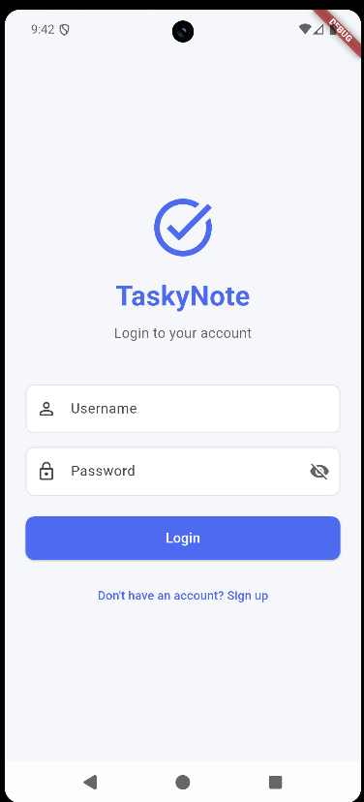
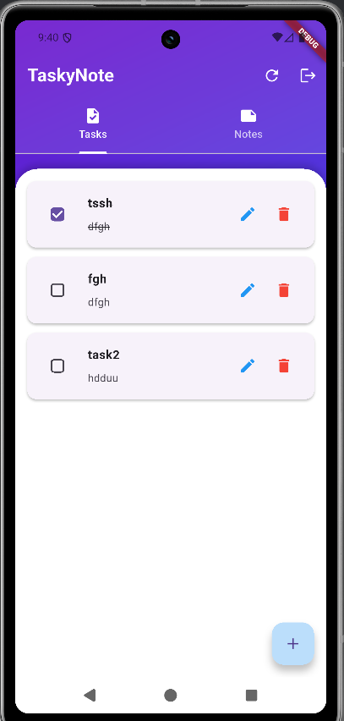
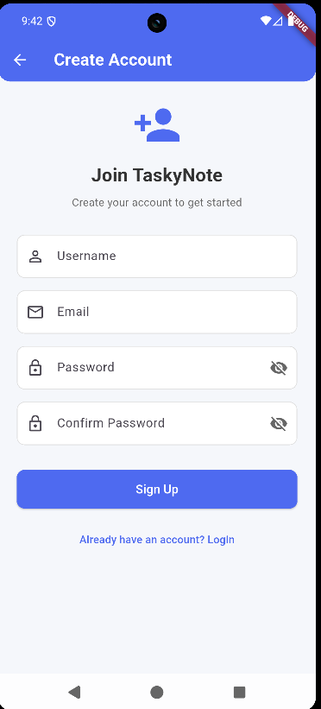

Slide 17
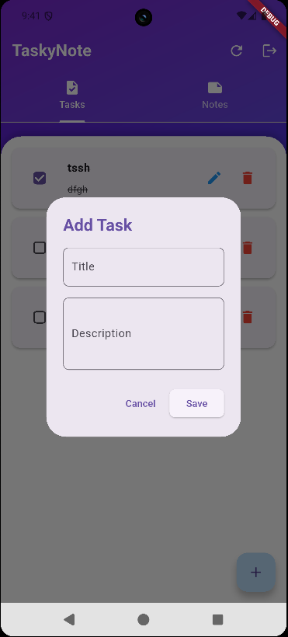
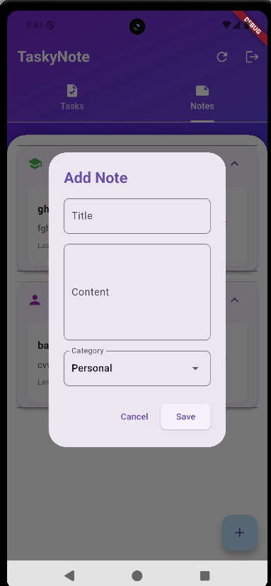
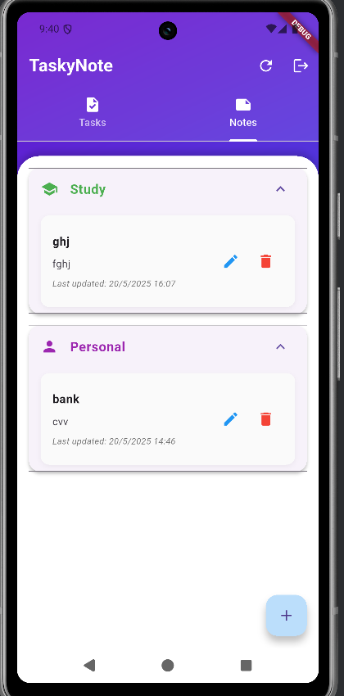

Slide 18
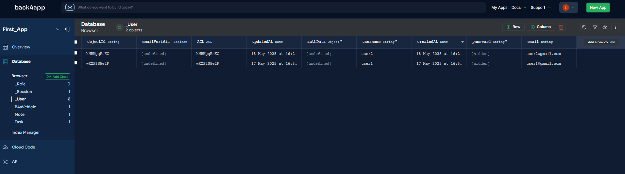
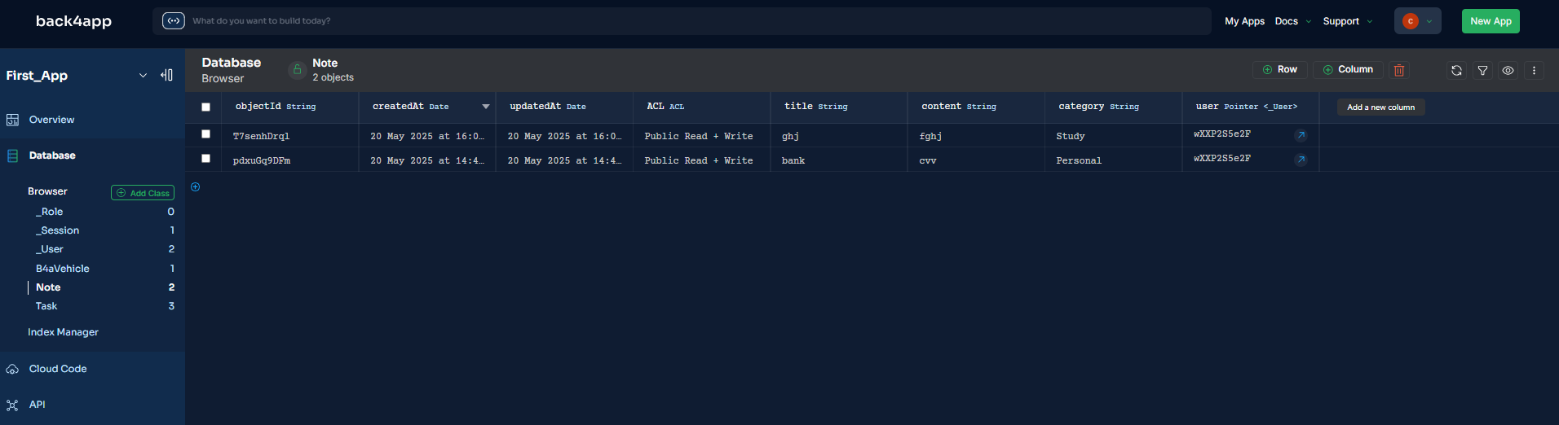

Slide 19
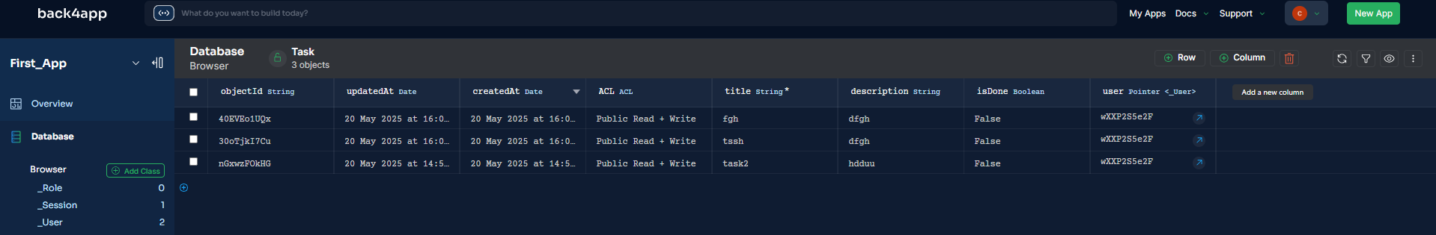

Slide 20
Learning Outcomes

Slide 21
Gained experience with Flutter’s widget tree and state management.
Learned to integrate backend services with Parse Server.
Improved skills in designing responsive and adaptive UI.
Leant low-code development with back4app framework

Slide 22
Thank you
Shaik Abdulla
ID: 2023TM93756
2023tm93756@wilp.bits-Pilani.ac.in

